Slide 1
SECTA - South Essex Construction Training Academy

Slide 2
Construction Skills Fund - Overview
CSF is part of Government’s National Retraining Scheme.
DFE funded, delivered via Construction Industry Training Board (CITB).
18 month programme – Oct 2018-March 2020
£20.8m to fund 27 hubs across the UK
Objective: To increase the number of people trained in construction skills to create a workforce to meet the needs of the sector.
Scope:
Onsite Training hubs – mobile training centres linked to significant construction projects or a programme of projects.
Employer led training – complementing existing routes into the sector.
Focus on prioritising older adults and non-traditional entrants to the sector.

Slide 3
SE Corridor Project – Key Parameters
Total project value £970,014.
Timescales: October 2018 – March 2020
Key Performance Indicators:
650 individuals who are considered employment and site ready by construction employers
195 trainees (30%) obtaining an offer for a job with sustained employment
360 (55%) trainees from non-traditional entry routes and from underrepresented groups
100 (15%) trainees from employment in other industries, particularly those which could be at risk of automation in future

Slide 4
SECTA Project & Programme Overview
DFE funded, delivered via Construction Industry Training Board (CITB).
18 month programme – Oct 2018-March 2020
Objective: To increase the number of people trained in construction to create a workforce to meet the needs of the Construction Industry.
Scope:
Employer led training programme– complementing existing routes into the sector.
Programme of our Project is run on a monthly turnaround & we have 3 hub locations – Basildon, Southend & Thurrock
1st week – Registration Day: Identify needs, assisting with needs & booking training and events
2nd & 3rd week – Scheduled Training Programmes – CSCS, H&S, Level 1 Trade Courses: Bricklaying, Tiling, Painting & Decorating and Carpentry - Look at individual Tailor made courses
4th week – Employer Event – Contractors, Employers, Support Agencies, Guest Speakers & Roles available
5th week – Possible Work Placements – gives you an intro to the company, learn new skills to add to your CV and show the employers what you have to offer. Vacancy outcome opportunities for each work placement. Site Visits can also be arranged on an ad hoc basis.

Slide 5
Construction is booming and there is a massive skills shortage!
The construction sector will need between 12,000 and 24,000 additional workers in the industry to keep up with expected growth in Essex alone.
There were over 11,000 vacancies within construction in 2017.
The advertised average salary of these jobs was £35,644.
There are majors projects in Essex and London that will require staff such as:
→ Lower Thames Crossing
→ Basildon, Southend & Thurrock Regeneration Projects
→ Stansted Airport Expansion
→ Crossrail
→ Canary Wharf Expansion
→ Thames Tideway Tunnel

Slide 6
From Manual to Skilled Workers
Manual Workers – New to construction
Information, Advice and Guidance
Employability skills
Employment / Site Ready
Employment Vacancies
Technical Training
Manual Workers – Previous experience
Level 1 H&S / CSCS
Agencies
Skilled Workers – New to construction
Work Experience
List of Employment Ready Clients
Skilled Workers – Previous experience
Apprenticeships
Employer Engagement Days
College leavers
Open Days
Women in Construction
Notes:
Referral Partners working to refer clients
Social media effective at spreading the word and recruiting clients
Motivated learners who want to get into construction
High pass rates for CSCS course
Link to agencies to get jobs: Hays & Jark
Link to refunds on transport when they get into work
Self employed info sessions
Holding the CSCS cards until they have employment

Slide 7
How we can work together

Slide 8
What we have from Construction Companies
Jobs
Vacancies – yours and your sub contractors
Work Experience
2 – 5 days
Meet the clients – when they complete the CSCS card with a view to recruitment
Site visits / Site open days
Speed interview
Consideration of SECTA work ready clients for employment

Slide 9
My Role as Client Manager
Develop an Action Plan on how we can help you achieve your goals
Supply you with opportunities for training in order you to achieve your goals
1-2-1 careers advice, guidance and support through the programme
Employment brokerage to help you find and secure a job
Help you over come any barriers that you may have.
Notes:
Assists with local employment targets – link with SV commitments and targets on inclusion

Slide 10
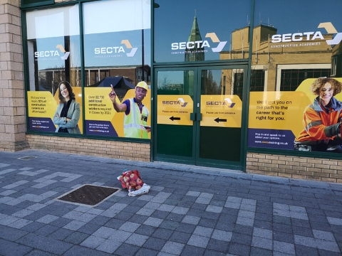
Promoting SECTA
Partner referrals
Website – www.sectatraining.co.uk
Facebook and Social media campaign
Leaflets
Posters
Roller Banners
Events

Slide 11
Any Questions

